Slide 1

Effects of process parameters on properties of BaAl₂O₄ based coating deposited by novel Explosive spray method and prediction of feature using Multivariate linear regression
1
Presentation by-
Shubham Birle
Department of Mechanical Engineering
Indian Institute of Technology Indore
Supervised by
Dr. Kazi Sabiruddin Dr. Chandresh Kumar Maurya
PSPC Members
Dr. S. Dhinakaran
Dr. Ranveer Singh
Dr. Md. Aquil Khan

Slide 2
CONTENTS
INTRODUCTION​
LITERATURE REVIEW​
OBJECTIVES​
MATERIALS AND METHODS​
RESULT AND DISCUSSION​
CONCLUSION​
FUTURE WORK​
REFERENCES​
​

Slide 3
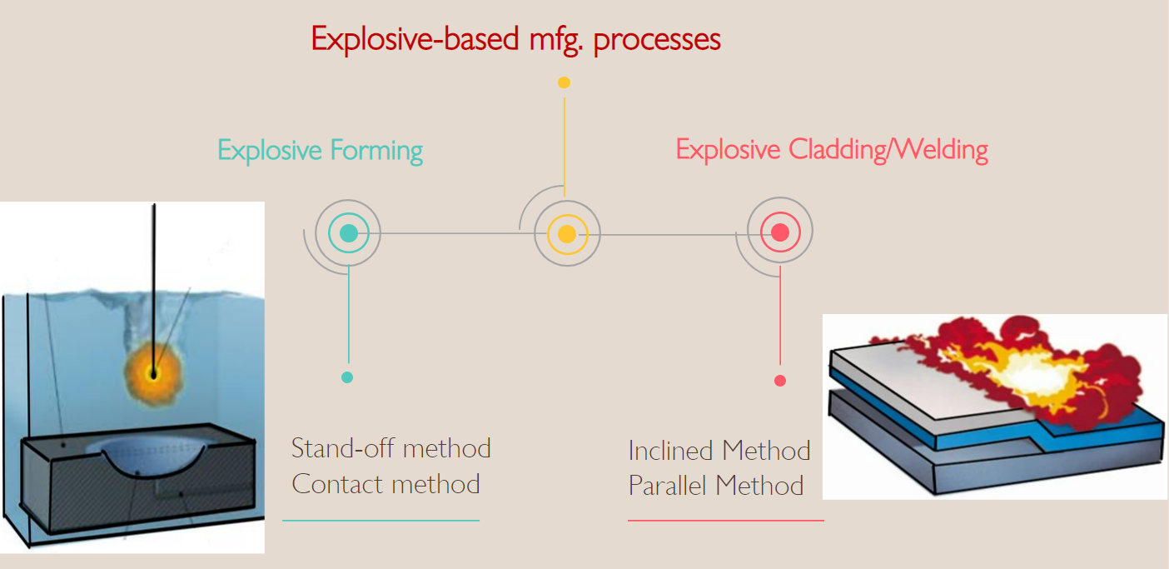
INTRODUCTION
3
Explosive used in manufacturing mostly in forming and welding purpose depending on the energy released from the explosion, explosive are classified as low and high explosive.
Low Explosive​ | High Explosive​
Flash powder ,​ Gunpowder​ | TNT, TNP, RDX​

Slide 4
INTRODUCTION
The coating efficiency directly or indirectly depends on many other parameters during Explosion, in which each one is interrelated with each other.
Multivariate Linear Regression can be used as a tool for processing a very large data related to Explosive process and to predict any desired coating characteristic, larger than the domain of experimentation.

Slide 5
LITERATURE REVIEW
YEAR​ ​ | AUTHOUR/S​ ​ | TITLE OF WORK​ ​ ​ | SIGNIFICANT FINDING​ ​
2021​ | K. Raghukandan​ | Microstructure, strength and welding window of aluminum alloy−stainless steel explosive cladding with different interlayers​ | The thickness of the flyer, the loading ratio, and the angle of inclination all play a role in the morphology and mechanical behavior of the weld. At the same time, the stand of distance has a minor impact.​
2015​ | Zaheer-ud-din, Abdul Qadeer MALIK​ | Thermal Decomposition, Ignition and Kinetic Evaluation of Magnesium and Aluminium Fuelled Pyrotechnic Compositions​ | Thermally stable - Mg + NH4ClO4 < Mg + KMnO4 < Al +Ba(NO3)2​
2020​ ​ ​ | Daisuke Inao et al.​ | Explosive Welding of Thin Aluminum Plate onto Magnesium Alloy Plate Using a Gelatin Layer as a Pressure-Transmitting Medium​ | successfully welded thin Al plates onto Mg alloys and ​ discovered characteristic wavy interfaces without intermediate layers using a pressure transmitting medium of gelatin. Gelatin's role as a pressure transmitting substance was shown to play a significant role in improving explosive welding​
2022​ | Bing-yuan Han​ | Performance analysis of plasma spray Ni60CuMo coatings on a ZL109 via a​ back propagation neural network model​ | a Back Propagation (BP) Artificial Neural Network model to predict the performance of Ni-based coatings.it was found that the increase and decrease trends of the two were similar and that the fitting degree was high, which indicates that the network has a high prediction accuracy.​

Slide 6
LITERATURE REVIEW
YEAR​ ​ | AUTHOUR/S​ ​ | TITLE OF WORK​ ​ ​ | SIGNIFICANT FINDING​ ​
2004​ | D. Meuken and E. P. Carton​ | Explosive Welding and cladding​ | showed the capability of explosive foil cladding as an alternate coating process with one or two foils on either side in one processing step. This technique can be used to clad any material combination, and ideal for increasing the parent material properties​
2017​ | I.A. Bataev​ | Structure of explosively welded materials: experimental study and numerical simulation​ | Wave & jet formation Structural changes at interface ​ High degrees of plastic deformation near interface​
2019​ | Huimin Wang Yuliang Wang ​ | High-Velocity Impact Welding Process: A Review​ | Bonding interface-wave, straight interface​
2022 | Shahid Hussain et al. | Effect of Ni-5Al Addition on the Properties of BaAl2O4-Based Coating Deposited with a Novel Explosive Spray Coating Technique | Setup develop

Slide 7
OBJECTIVES
To deposit Al₂O₃ and BaAl₂O₄ composite coating on steel substrate by varying the feedstock compositions and stand of distance(SOD).
Study the properties and behaviour of the deposited coating.
To predict mechanical properties using Multivariate linear regression.

Slide 8
MATERIALS AND METHODS
Grit Blasting
Cleaning
Substrate Selection
Preheating
Substrate​ AISI 1020 Flat ​ ​
Element​ | Wt.(%)​
Fe ​ | 99.08-99.53​
Mn​ | 0.30-0.60​
C​ | 0.170-0.230​
S​ | <0.05​
P​ | <0.04​
Manual Cleaning, Ultrasonic Cleaning
Table: Grit blasting parameters ​
Grit type & Size​ | Alumina, 24 mesh ​
Blasting pressure (kgf/cm²)​ | 5​
Blasting Time (Minutes)​ | 1​
Stand off distance(mm)​ | 100 ​
Roughness​ | 5-7 μm​
Table: Substrate preheating parameters (muffle furnace)​
Time (min.)​ | 15 ​
Temp.(◦C)​ | 350​

Slide 9
MATERIALS AND METHODS
Powder selection
Powder preheating
Flash powder​
Elements​ | Content(by weight in gm)​
Al​ | 1,1.5,2,2.5​
Ba(NO₃)₂ ​ | 2
10Al + 3Ba(NO₃)₂ → 5Al₂O₃ + 3BaO + 3N₂ +445.8 kJ
Powder preheating Parameters (muffle furnace)​
Time (min.)​ | 5​
Temp. (°C)​ | 100​
Varying composition of the flash powder​
Sample Names.​ | Al(1)​ Ba(NO₃)₂ (2)​ | Al(1.5)​ Ba(NO₃)₂ (2)​ | Al(2)​ Ba(NO₃)₂ (2)​ | Al(2.5)​ Ba(NO₃)₂ (2)​
Al/pyro quantity(gm)​ | 1​ | 1.5 ​ | 2​ | 2.5 ​
Barium Nitrate quantity (gm)​ | 2 | 2 | 2 | 2 ​

Slide 10
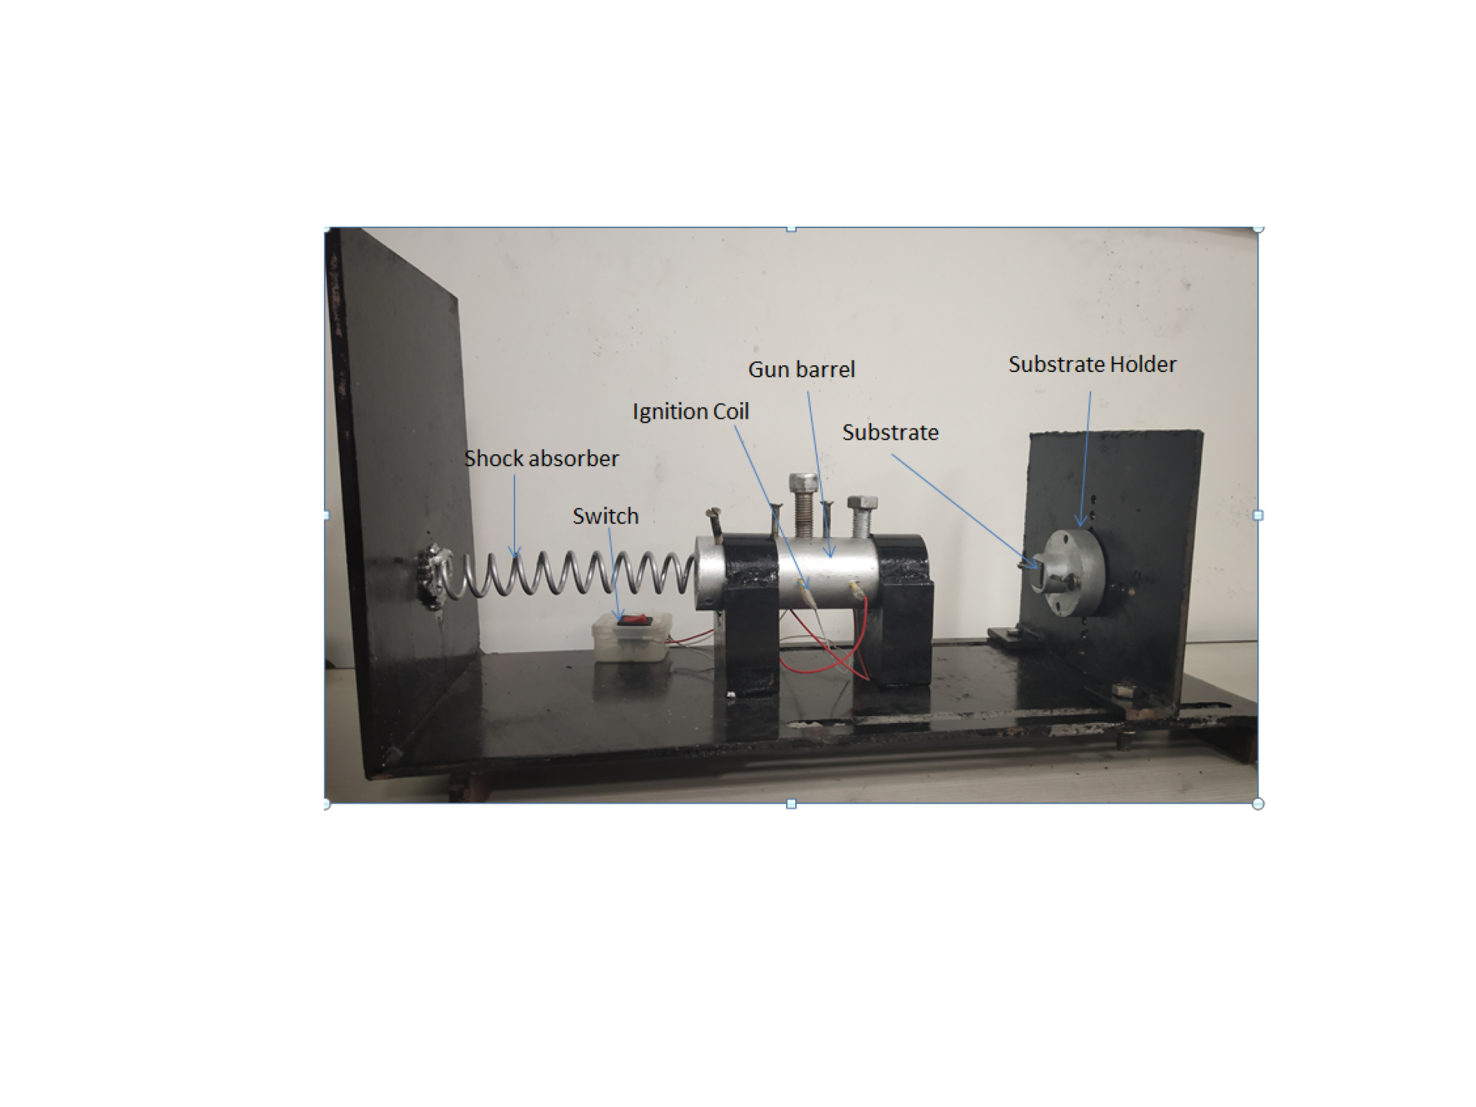
EXPLOSIVE SPRAY COATING SETUP
SOD
Double point ignition system
Mixed Form
and SOD

Slide 11
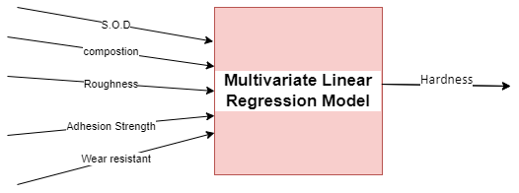
MULTIVARIATE LINEAR REGRESSION METHOD
Multivariate (Multiple) Linear Regression is a statistical test used to predict Hardness using one or more other variables.

Slide 12
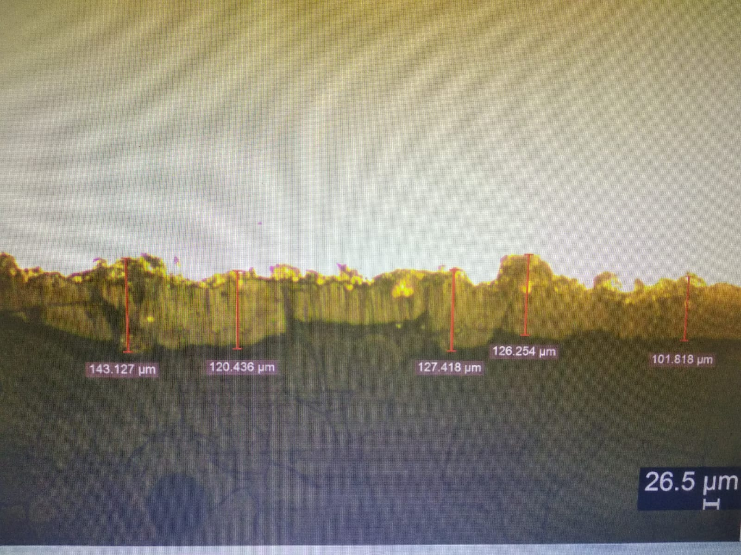
RESULTS AND DISCUSSION
COATING THICKNESS ANALYSIS
Ba(NO₃)₂=2gm(const.)
Al-2gm, Ba(NO₃)₂=2gm,SOD=60

Slide 13
FESEM Images
Ba(NO₃)₂=2gm(const.)
SOD=60mm
Globules
Al=1gm
Al-1.5gm
Al-2gm
Al-2.5gm

Slide 14
COATING ROUGHNESS ANALYSIS
Ba(NO₃)₂=2gm(const.)

Slide 15
Cross Sectional SEM Image
SOD- 60
Al-1gm
Ba(NO₃)₂
resin
Coating
porosity
Substrate

Slide 16
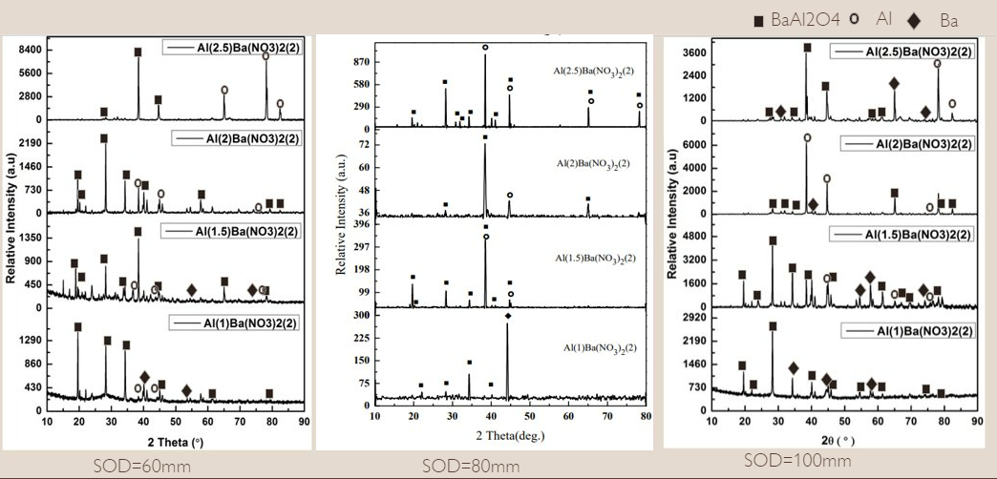
XRD ANALYSIS OF COATING

Slide 17
HARDNESS OF COATING
Ba(NO₃)₂=2gm(const.)

Slide 18

HARDNESS ANALYSIS OF SUBSTRATE AT DIFFERENT DEPTH
SOD=60mm
resin
Coating
(150,192)
180μm
Substrate
Al 2gm
Ba(NO₃)₂ 2gm
SOD=60mm
180 um

Slide 19
HARDNESS ANALYSIS OF SUBSTRATE AT DIFFERENT DEPTH
resin
Coating
SOD=100mm
180μm
Substrate
Al 2gm
Ba(NO₃)₂ 2gm
SOD=60mm

Slide 20
CONCLUSIONS
BaAl₂O₄ based composite coatings are successfully fabricated on preheated mild steel substrate by varying amount of Al and SOD.
With an increase in Al content the roughness of coating is increases.
With an increase in Al content hardness of coating is increase up to 2gm of Al.
The depth of hardened substrate is decreased with increased Al content however, the amount of hardness right beneath the interface is increased with an increase in Al content.
With an increase in the stand of distance(SOD) coating thickness first increased and then beyond a certain value it tends to decrease.
20

Slide 21
FUTURE PLAN
M-Tech project progress
Phase 1 (Mid sem 2022) | Phase 2 (End sem 2022) | Phase 3 (Mid sem 2023) | Phase 4 (End sem 2023)
Literature Review | Roughness Analysis | Cross sectional Microstructure study, EDS analysis | Machine leaning model to predict hardness
Substrate preparation | Phase analysis | Adhesion Test | Preparing manuscript for publication
Coating fabrication | Hardness analysis | Data Pre-processing

Slide 22
REFERENCES:
Sonali Brahmane(2022).Thesis of Production of monolayer grinding wheel by novel explosive spray coating method. P
Sharma, Mayank. (2015). Thesis of manufacturing explosively coated tools.68.
Chattopadhyay, A., A., & Paul, S. (2008, october 20). Retrieved from LM- 15.PDF.NPTEL: http//nptel.ac.in
Chattopadhyay, A., & Paul, S. (2008, october 20). Retrieved from LM- 16.PDF.NPTEL: http//nptel.ac.in
Bataev, I. (2017). Structure of Explosively Welded Materials: Experimental Study and Numerical. Bataev I.A. Structure of explosively welded materials: experimental study and numerical simulation. Obrabotka metallov (tekhnologiya,, 9.
Crossland, B. (1982). Explosive welding of metals and its Appllications. Newyork: Oxford Science Publications.
T.Z.BLAZYNSKI. (1983). EXPLOSIVE WELDING,FORMING AND COMPACTION. LONDON: APPLIED SCIENCE PUBLISHERS.
Wang, H., & Wang, Y. (2019). High-Velocity Impact Welding Process: A Review. Metals 2019,9,144, 18.

Slide 23
Chattopadhyay, A. (2015, March). Abrasive Processes. Retrieved from nptel iit khargpur: http://nptel.ac.in
Paredes, R., Amico, S. C., & d’Oliveira, A. (2006). The effect of roughness and pre-heating of the substrate on the. R.S.C. Paredes et al. / Surface & Coatings Technology, 7.
Tucker. R.C. (2013). Introduction to Coating. ASM Handbook, Volume 5A, Thermal Spray Technology, 13.
Ferrer, M., Vargas, F., Moreno, C., & Peña, G. (2017). Effect of temperature and substrate roughness on the adhesion of coatings of nI alloy deposited by flame spray. Rev. LatinAm. Metal. Mat., 10.
BABAR, Z. -u.-d., & MALIK, A. Q. ( 2015). Thermal Decomposition, Ignition and Kinetic Evaluation. Central European Journal of Energetic Materials, 14.
Shivapirakasam, S. P., Suryanarayanan , M., & Chandrasekaran, F. (2009). Thermal characterization of pyrotechnic flash compositions. S.P.Shivapirakasam et.al, 6.
Tawakoli, T., & Vesali, A. (November 9-15, 2012). Dynamic behaviour of the different wheel hub material in high efficiency deep grinding (HEDG). Proceedings of the ASME 2012 International Mechanical Engineering Congress & Exposition , 8.

Slide 24
Thank you

Slide 25
HARDNESS ANALYSIS OF SUBSTRATE AT DIFFERENT DEPTH
SOD=80mm
resin
Coating
180μm
Substrate
Al 2gm
Ba(NO₃)₂ 2gm
SOD=60mm

